Slide 1


CLIMATE CHANGE
IT204F Project Proposal
By: Megan, Jenyne, Qiao Yi, Evangeline

Slide 2

Background Information:
Educate the public on climate change

Slide 3
What’s in the app?
01 - INTRODUCTION
02 - QUIZ
03 - ECO CATCHER
04 - SURVIVE THE CLIMATE

Slide 4


INTRODUCTION
Introducing facts on climate change in a game form!
Fact 1( ¼ of the cause of Climate change was made by greenhouse gases emission)
Fact 2 (Cutting down trees can actually lead to climate change)
Scene 1

Slide 5
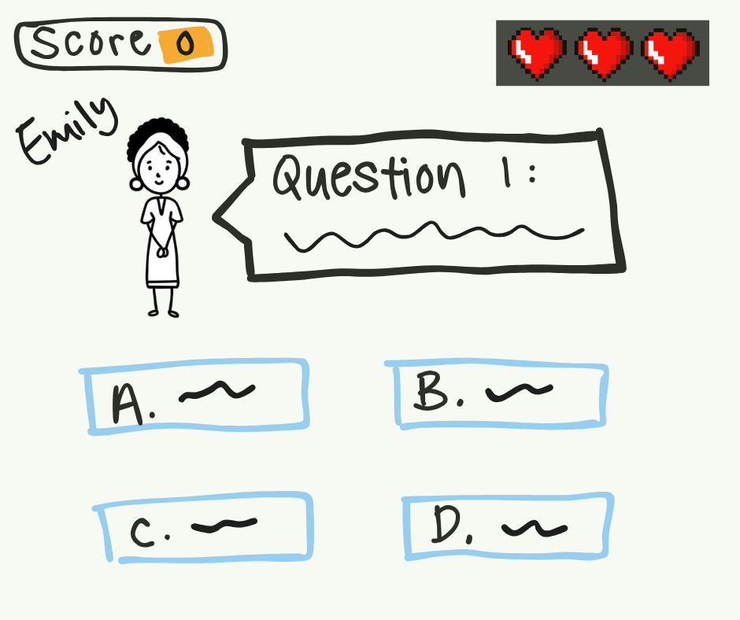
QUIZ
Quiz game to test users’ understanding of what was covered in Scene 1 about the introduction
( Facts on Climate Change )
Consist of 3 lives which users need to make sure not to use up to complete the quiz

Slide 6
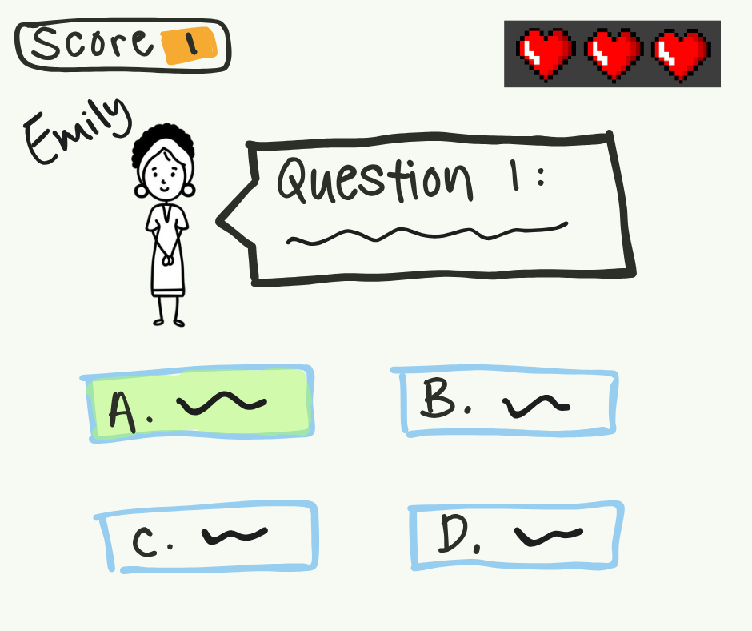
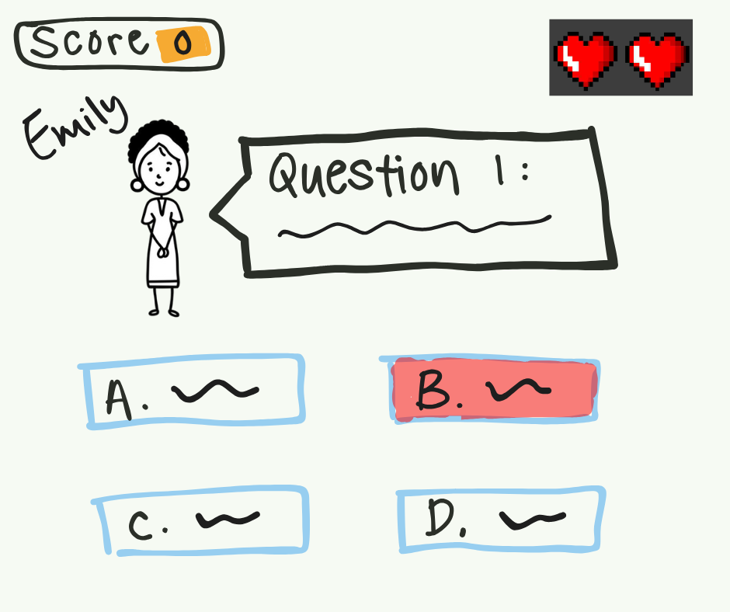
When answered
correctly:
When answered
wrongly:
No life will be lost
Option turns green and a “Ding” sound effect will be heard
A life will be lost
Option turns red and a “Buzzer” sound effect will be heard

Slide 7
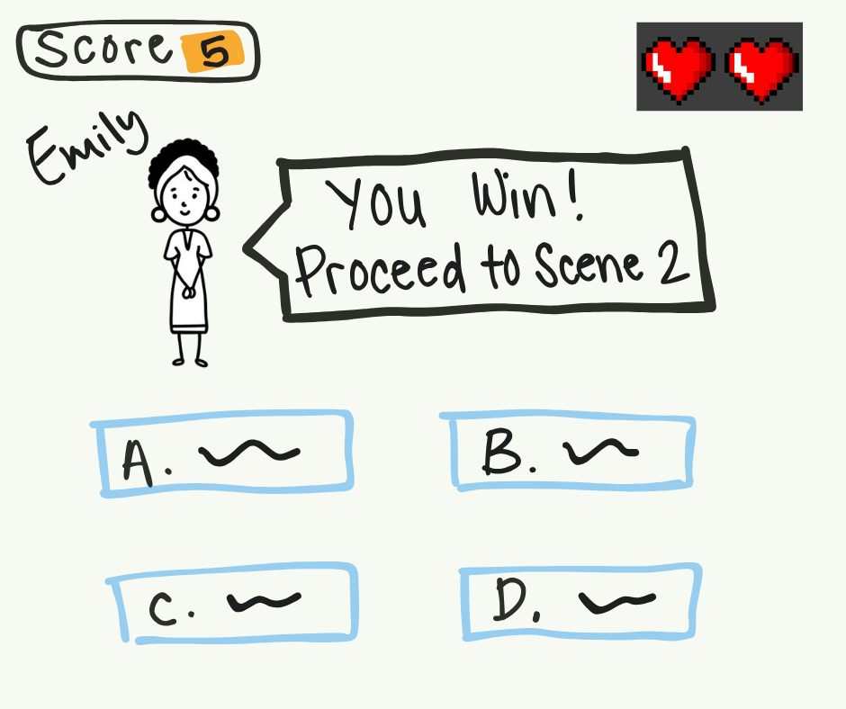
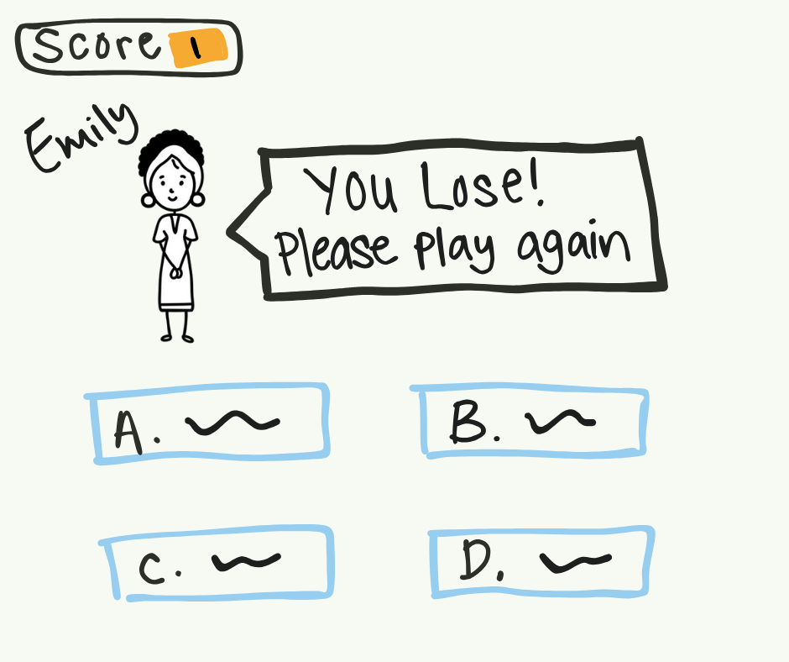
When users answered all questions correctly while having 1 or more lives left:
When users loses all 3 lives regardless of which question number they are at:

Slide 8

INTRODUCTION
Introducing the impact of climate change on us
Impact 1: Raising Temp
Impact 2 : Lesser Resources
Scene 2:

Slide 9

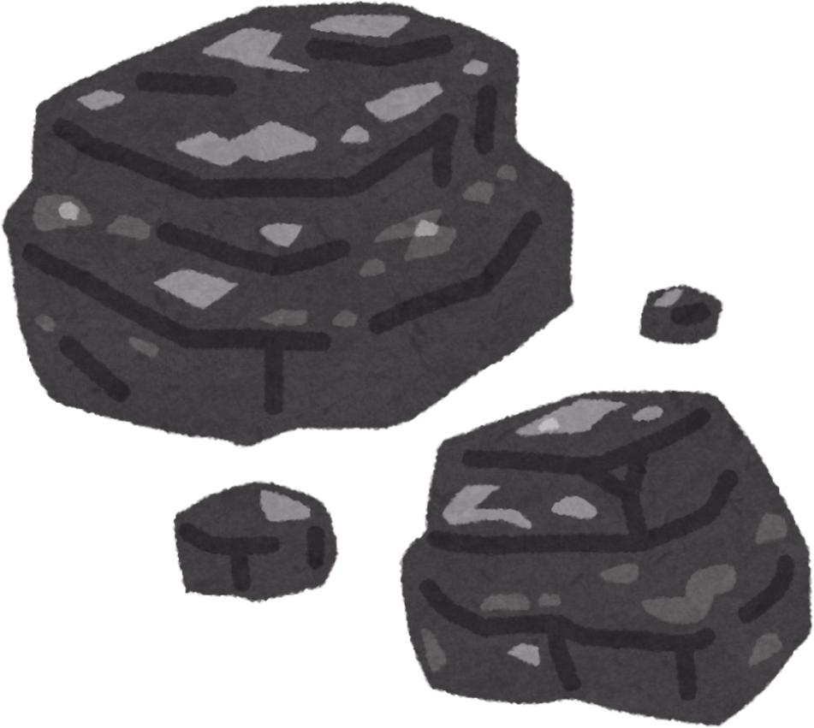

SURVIVE THE CLIMATE GAME
Renewable energy= Slows climate change
Objective: Collect solar panels and dodge the coal
If the entity like coal is chases and makes contact with her, she loses a life
After they have collected the 5 solar panels and they are still alive the game ends and they win.
If they have lost their lives it flashes a retry button

Slide 10

Background of the map:

Slide 11
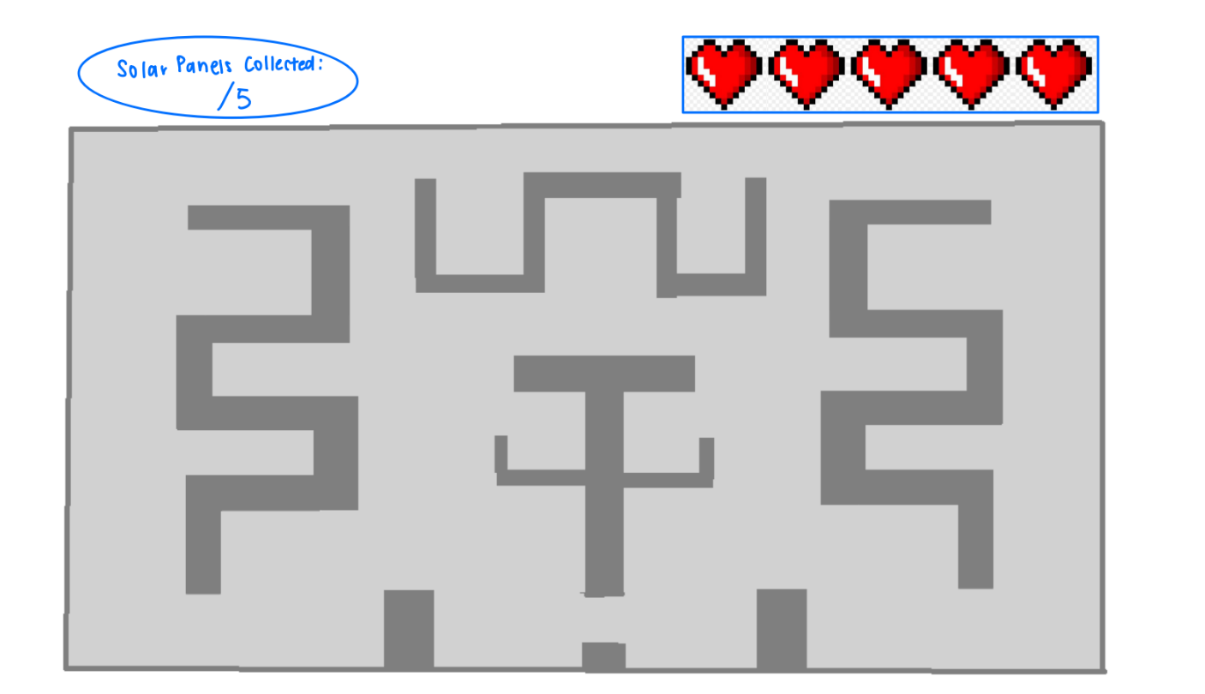


Overall how the game would look

Slide 12

01 - INTRODUCTION
What “we” can do to reduce climate change
Tip1: Gardening
Tip2:3rs
(Reuse,Reduce,Recycle)
Scene 3:

Slide 13
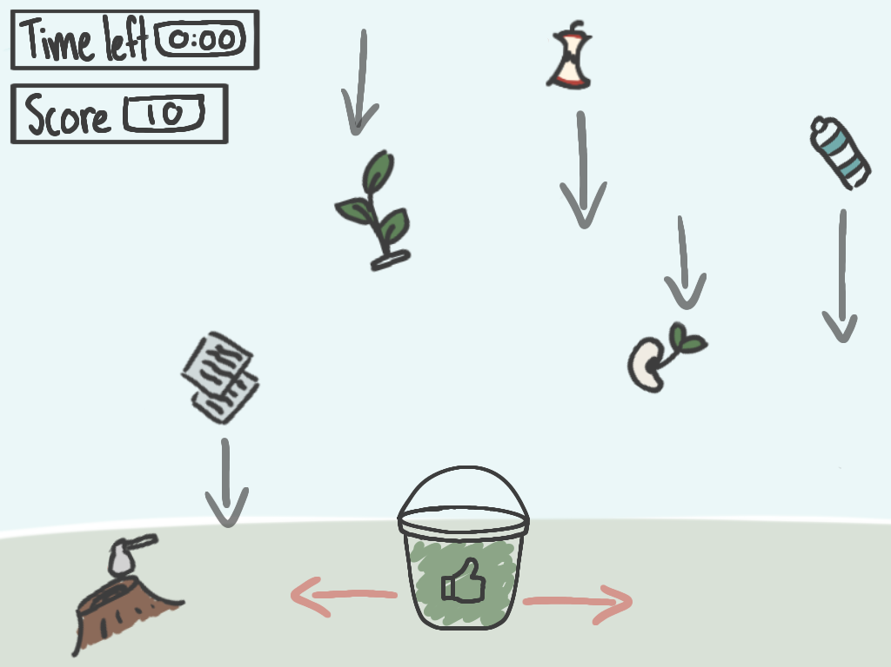
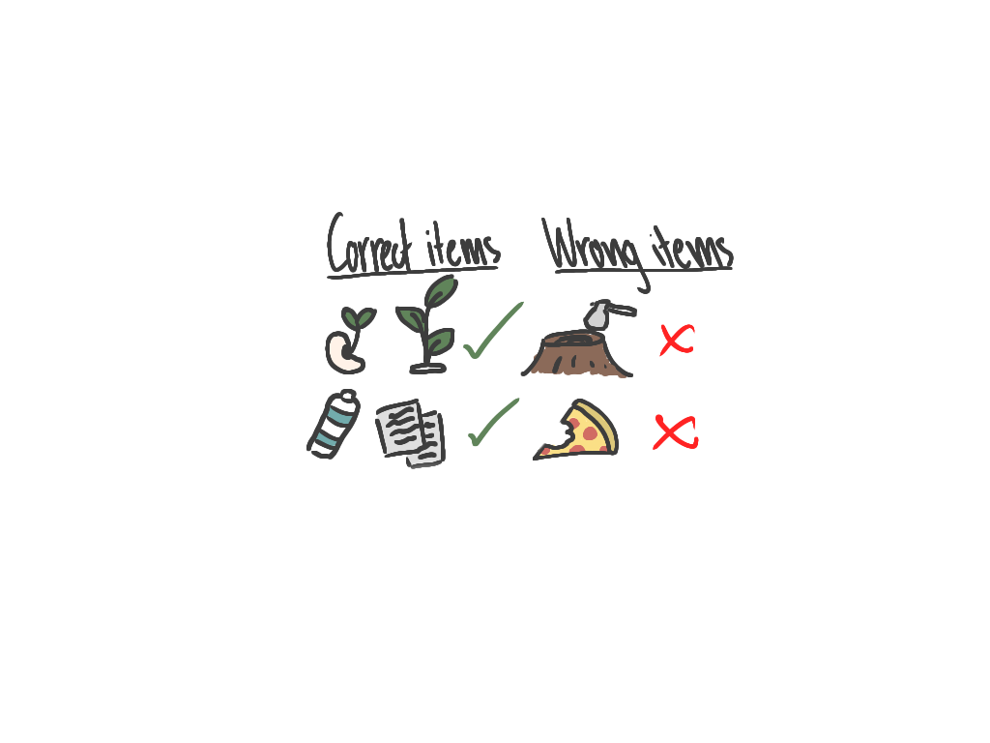
ECO CATCHER
Objective: User has to collect a certain number of “Correct items” (recyclable items/tree samples) within a time limit to win in order move on to the next scene
Sprites to collect & avoid:

Slide 14


THANKS

